Slide 1
Predicting water capacity in Chennai reservoirs
ECM2002 – MACHINE LEARNING ALGORITHMS
BY
AVULA.ROHITHA – 17BLC1007
K.MADHU SWAPNIKA- 17BLC1024

Slide 2
Objective of the Project
Good morning!
These days we are going through water crisis.
To predict the water capacity of all reservoirs in Chennai to overcome water crisis in less water capacity areas
To know how bad is the water crisis compared to previous years.
Visualize the water need / usage of the city
Identify whether the water sources availability will be able to meet the needs till the subsequent monsoon?

Slide 3
Motivation for selecting (or creating) the dataset
As ML engineer its data which is the most important and powerful tool in our hands.
So here we download the dataset from the website
https://www.kaggle.com/sudalairajkumar/chennai-water-management
The motivation behind this dataset is Chennai is entirely dependent on ground water resources to meet its water needs. There are four reservoirs in the city, namely, Red Hills, Cholavaram, Pondi and Chembarambakkam, with a combined capacity of 11,057 mcft. These are the major sources of fresh water for the city.And to give some suggestion to overcome water crisis.

Slide 4
Description of the dataset
This dataset has details about the water availability in the four main reservoirs over the last 15 years
Pondi
Cholavaram
Redhills
Chembarambakkam
Status
The data is available on a daily basis and the unit is million cubic feet.
This output variable is given as a rating from 0-1 showing the water capacity is whether maximum or minimum

Slide 5
Details of data pre-processing
As all machine learning models require data pre-processing ,there were few pre-processing steps done to meet the demands of machine learning models which are as follows:
1) A lot of pre-processing had to be done to clean the data so that it can be turned into a usable format.
2) Normalizing data was taken to fill their missing values in the dataset
3)The data extracted is then written into a csv file and thus 2 files of train and test are created.

Slide 6
Overview of Linear models used
1.Linear Regression:
In this model, different significant parameters were used at a time to predict . Since there were more than one significant columns, model was not able to fit to the test set properly.
2.Multiple Linear Regression:
To increase the prediction accuracy, different parameters which affects the prediction were found out using their P values.

Slide 7
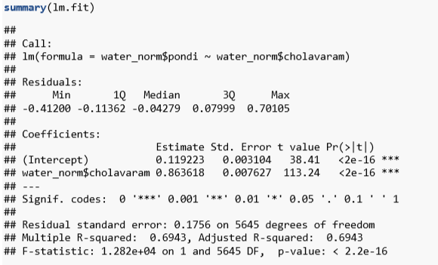
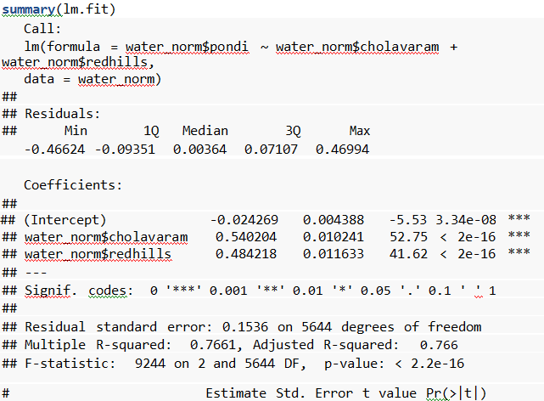
Overviews of Linear Models used
The summary of the same gives us an idea about the important variables which gives impact to the output.
LINEAR : MULTIPLE :

Slide 8
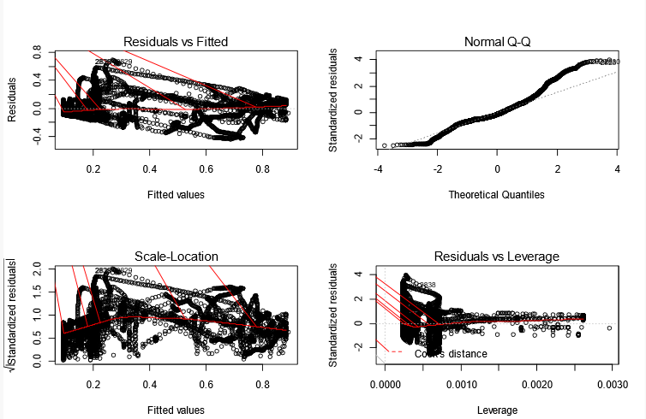
Overviews of Linear Models used
We now look at the linear regression but with smaller model after removing unimportant variables:

Slide 9
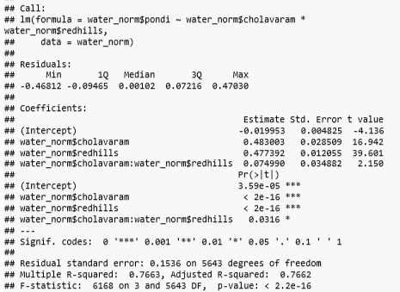
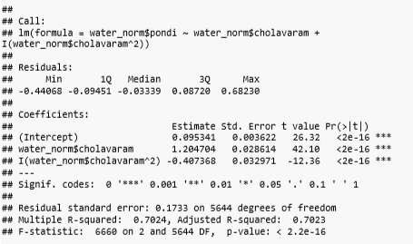
Non linear terms and their interaction Interaction: Non linear:

Slide 10
Details of methodology used for model selection and regularisation
While there many model selection methods out there, backward elimination method is being used in this project.
In Backward elimination there are five steps as follows:
1)Fit a significance level to stay in the model.
2)Fit the model with possible predictors.
3)Consider the predictor with highest p value, if p>sl ,go to step 4,otherwise include as significant one.
4) Remove the predictor
5)Fit the model

Slide 11
Comparative analysis of performance of Linear models
When linear regression and multiple linear regression were compared, multiple regression proved to be a better model than linear.In multiple regression ,Multiple R-squared: 0.7661, Adjusted R-squared: 0.766 value also tells us that it is a better model.
R-squared Value:-
Linear Regression | Multiple Regression
0.6943 | 0.7661

Slide 12
Classification models
LOGISTIC REGRESSION
mean(glm.pred==water_norm$status)
## [1] 0.9555516
LINEAR DISCRIMINANT ANALYSIS
mean(lda.class==status.2019)
## [1] 0.01
QUADRATIC DISCRIMINANT ANALYSIS
mean(qda.class==status.2019)
## [1] 0.6547619
K-NEAREST NEIGHBOURS
mean(knn.pred==status.2019)
## [1] 0.2

Slide 13
Overviews of Linear Models used
From the previous slide we infer that LDA and Knn gives max accuracy of 0.01 and 0.2
We can also infer that is the most stable fit as it gives max accuracy in both the cases.
Thus the linear models are analysed.
Now we’ll move forward to validation test and try to infer from the plots.

Slide 14
Details of Validation tests
This LOOCV is used find the degree of each predictors that can be used to give the best fit.
It can be clearly seen that polynomial fit of degree 1 gives least cv error.
To estimate the test error rates that result from fitting linear models on data sets.
The model is fit on training set and the fitted model is used to predict the responses for the observations in the validation set.
In the next slide we can look the same but for 10-fold CV.

Slide 15
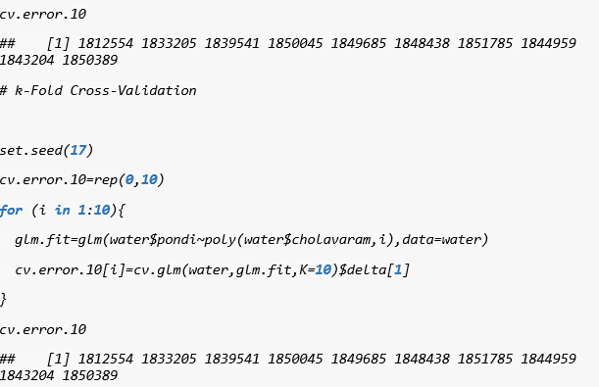
Details of Validation tests
Thus we can see that LOOCV and 10-fold performs almost exactly same way.
But it is prefered that we use 10-fold here because of its high computational speed compared to LOOCV.

Slide 16
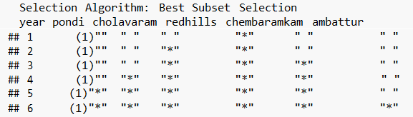
Details of methodology used for model selection and regularisation
We now look at the various models used in the project find the best predictors for our dataset.
Best subset:

Slide 17
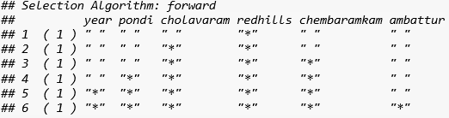
Details of methodology used for model selection and regularisation
From the summary we can see what are the models to be used for various subsets.
Forward Stepwise:

Slide 18
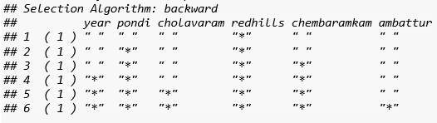
Details of methodology used for model selection and regularisation
We can notice that once an important model is added to the group it is never removed this is the concept for backward substitution also.
Backward substitution:

Slide 19
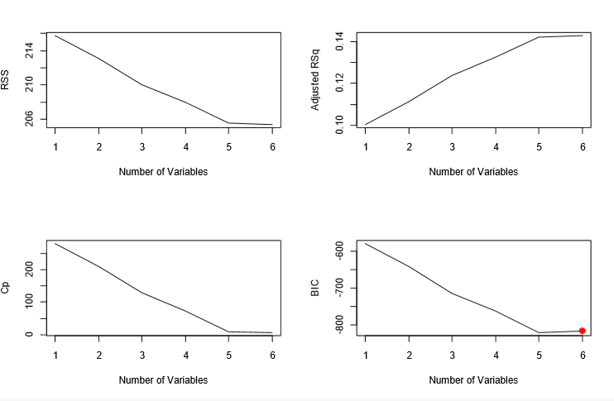
Details of methodology used for model selection and regularisation
We take the number variables which has least bic statistic.And we can see that all the best subset, forward and backward subset gives the same output that the model with 3 variables gives best fit.

Slide 20
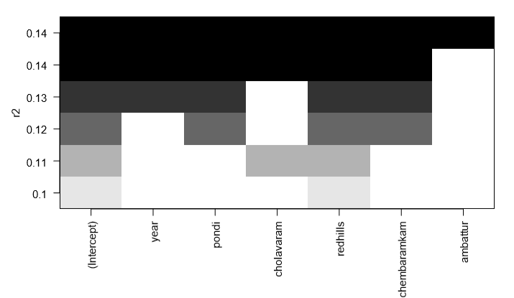
Details of methodology used for model selection and regularisation

Slide 21
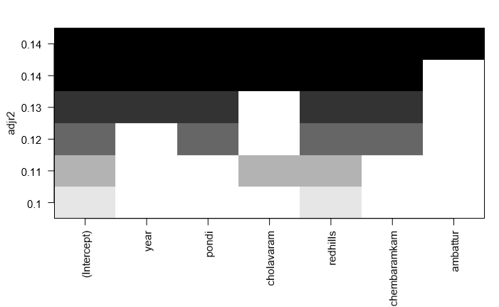
Continued >>

Slide 22
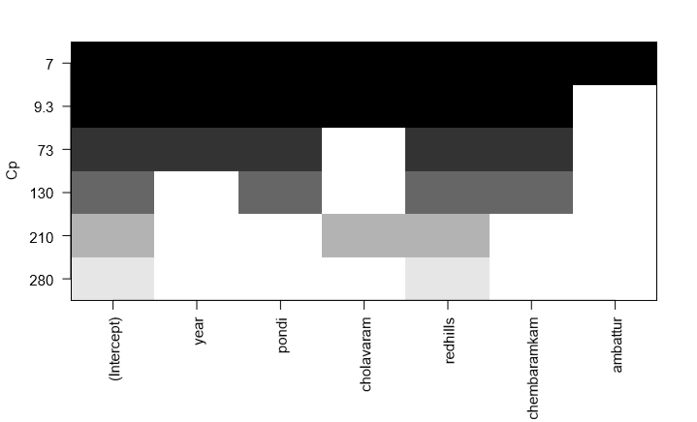
Continued >>

Slide 23
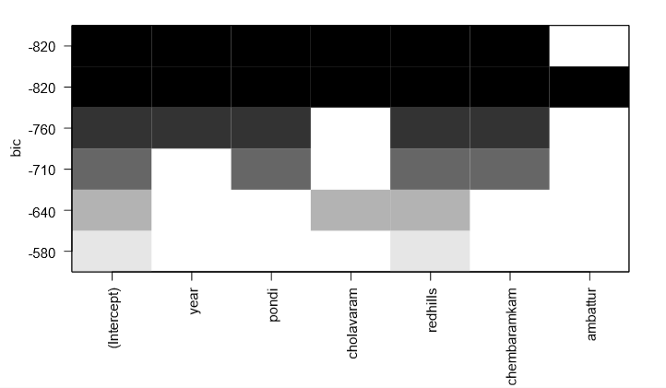
Continued>>

Slide 24
Details of methodology used for model selection and regularisation
The Root mean RSS error shows that error is monotonically decreasing in forward stepwise. This is true because every time when a new variable is included it improves the fit and hence error decreases.
LASSO
Ridge regression with a choice of lambda can outperform least squares as well as null model.Coefficent plot depends on choice of tuning.
RIDGE REGRESSION
In Lasso some coefficient estimates are zero so the lasso model with lambda is chosen by cross validation .

Slide 25
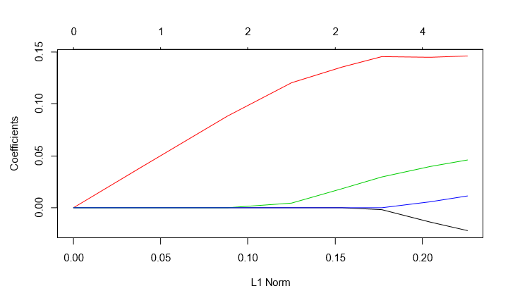
Details of methodology used for model selection and regularisation

Slide 26
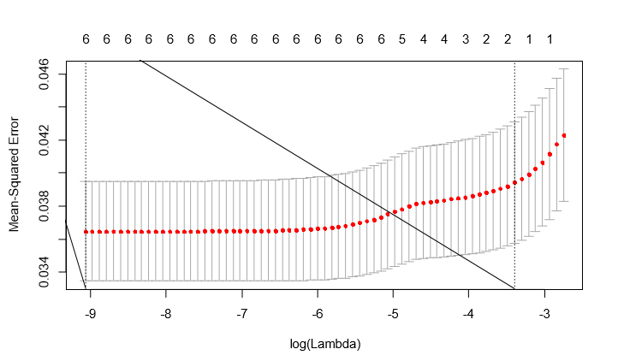
Details of methodology used for model selection and regularisation
10- fold CV of Lasso:

Slide 27
Ridge Regression and Lasso
Ridge Regression for lambda =0
mean((ridge.pred-y.test)^2)
## [1] 0.04151898
mean((mean(y[train])-y.test)^2)
## [1] 0.04262695
For best Lambda
mean((ridge.pred-y.test)^2)
## [1] 0.03657633
Lasso
mean((lasso.pred-y.test)^2)
## [1] 0.03818457

Slide 28
Details of methodology used for model selection and regularisation
Here coefficients are the beta terms
Higher the lambda lower the beta and becomes 0 at one point.
When lambda is 0, then model behaves as normal RSS.
Unlike forward or best subset, here no predictor is dropped, it only shrinks the parameter.

Slide 29
Overview of Non linear models used
Now lets look at the non linear models for fitting the data.
We first look at decision trees in next slide >>

Slide 30
Overview of Non linear models used
Decision trees:

Slide 31
Overview of Non linear models used
The tree is bit difficult to decode but we can see in the node hit and fail
This is highly useful to look at the parameters and their boundary till which reservoir is hit
Thus one can easily infer what reservoir is causing water crisis in chennai.

Slide 32
Overview of Non linear models used
Pruning is done so that it makes the DT shallow so that it is better for visualizing.

Slide 33
Overview of Non linear models used
Random forests:
We now see the plots of out of bagging

Slide 34
Overview of Non linear models used
Boosting:
Boosting gives the best method for selecting the model by giving a bar plot of the importance of each predictor.

Slide 35
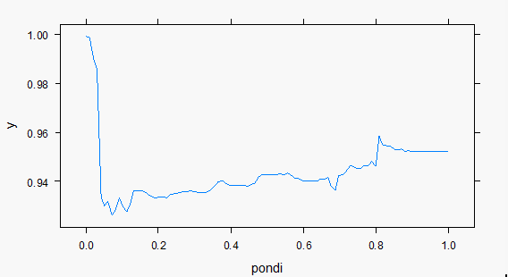
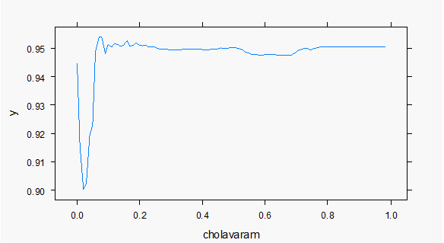
Overview of Non linear models used In the previous slides because of space constraints we could’nt see the things listed in y-axis .It is seen that pondi and other reservoirs are first three lines in the plot which has maximum importance.We can see the impact of them individually.

Slide 36
Overview of Non linear models used
We see that the training error rate is 0.005%
77% of the test observations are correctly classified ,so not only has the pruning process produced a more interpretable tree,but it has also improved the classification accuracy.
The test set MSE associated with bagged regression tree is 6.416963e-05,almost half that obtained using an optimally- pruned single tree.
The test MSE is 0.4851865;this indicates that random forests yielded an improvement over bagging.
The test MSE obtained is 0.01899495 when lamda=0.001
In case of lambda= 0.2 MSE is 0.02205249

Slide 37
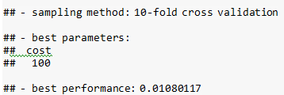
Support Vector Machines
We see that cost = 100 results in the lowest cross-validation error.

Slide 38
SVM Plots

Slide 39
Continued>>

Slide 40
Overview of Non linear models used
We can see clearly that redhills has enough and constant water capacity since many years , cholavaram water capacity is getting decreased, as water capacity increases crisis gets decreased
But as the water capacity increases we see that crisis gets decreases.
Thus it has a negative slope and that is why coefficient of crisis is also negative.

Slide 41
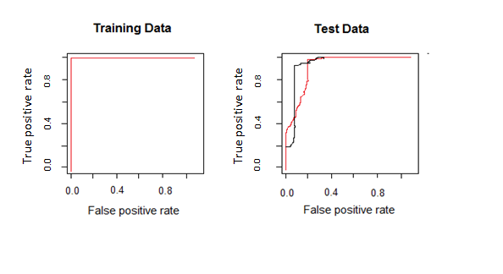
ROC curve
We here see ROC curves on training and test data

Slide 42
Recommendation of which model is the most suited and why
We now come to the final conclusion
The accuracy rates are of various models are as follows:
Logistic regression:
MSE = 0.9555516
LDA
MSE = 0.01
QDA
MSE = 0.06547619
KNN
MSE = 0.2

Slide 43
Recommendation of which model is the most suited and why
Random forests
MSE = 0.4851865
Boosting
MSE = 0.01899495 when lambda=0.001
MSE = 0.02205249 when lambda = 0.2
Thus it is clearly evident that boosting is the model to be used It happened to give us the most accurate prediction on testing set data compared to all other models in non linear models.

Slide 44
Thank you!

